Slide 1
Object Oriented Programming—C++ Lecture4 Streams
Qijun Zhao
College of Computer Science
Sichuan University
Spring 2023

Slide 2
Recap
- Uniform Initialization
- A “uniform” way to initialize variables of different types!
- References
- Allow us to alias variables
- Const
- Allow us to specify that a variable can’t be modified

Slide 3
Today
- What are streams?
- Output streams
- Input streams
- String streams!

Slide 4
Definition
stream: an abstraction for input/output. Streams convert between data and the string representation
of data.

Slide 5
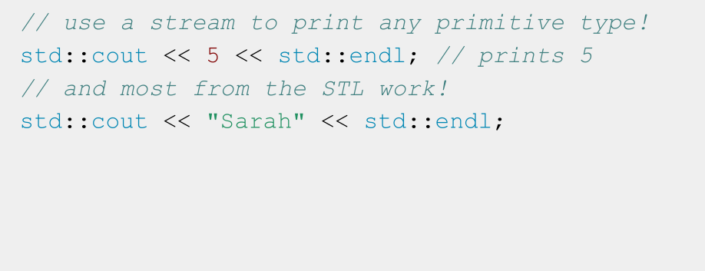
A stream you’ve used: cout

Slide 6
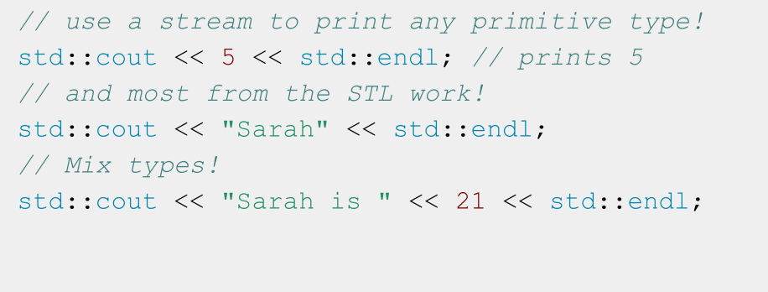
A stream you’ve used: cout

Slide 7
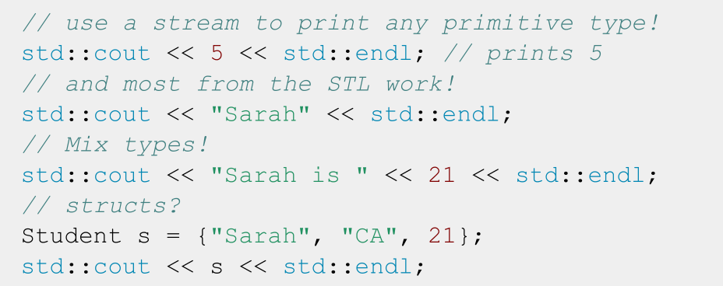
A stream you’ve used: cout

Slide 8
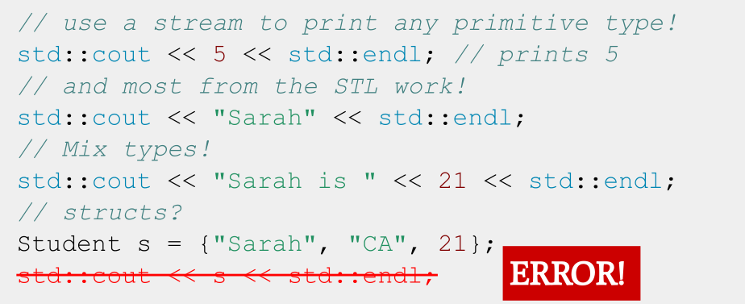
A stream you’ve used: cout

Slide 9
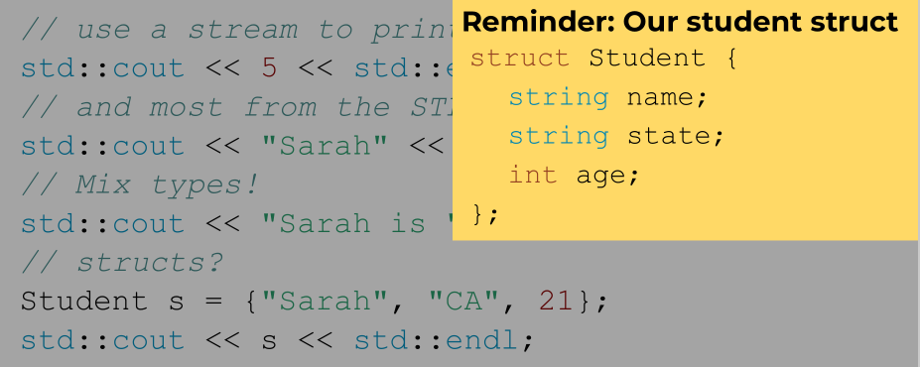
A stream you’ve used: cout

Slide 10
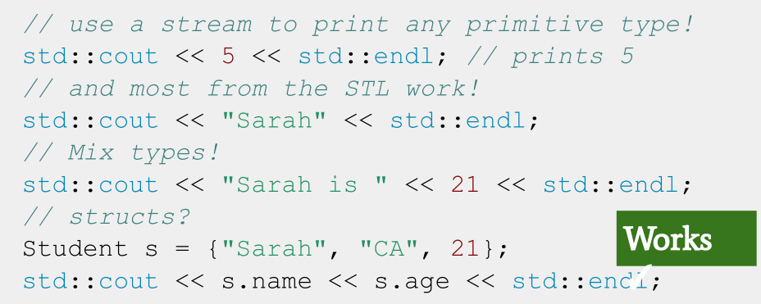
A stream you’ve used: cout

Slide 11
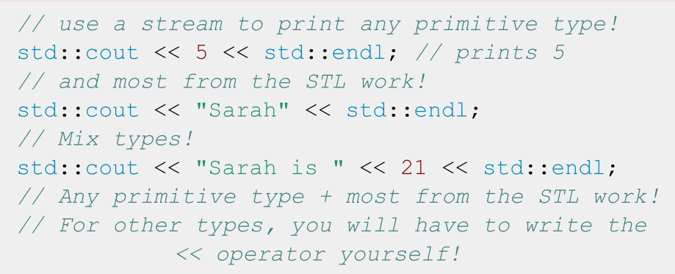

A stream you’ve used: cout

Slide 12
std::cout is an output
stream. It has type
std::ostream

Slide 13
Two ways to classify streams
By Direction:
By Source or Destination:
● Input streams: Used for
reading data (ex. ‘std::istream’,
‘std::cin’)
● Output streams: Used for
writing data (ex. ‘std::ostream’,
‘std::cout’)
● Input/Output streams: Used
for both reading and writing
data (ex. ‘std::iostream’,
‘std::stringstream’)
● Console streams: Read/write to
console (ex. ‘std::cout’,
‘std::cin’)
● File streams: Read/write to files
(ex. ‘std::fstream’, ‘std::ifstream’,
‘std::ofstream’)
● String streams: Read/write to
strings (ex. ‘std::stringstream’,
‘std::istringstream’,
‘std::ostringstream’)

Slide 14
Today
- What are streams?
- Output streams
- Input streams
- String streams!

Slide 15
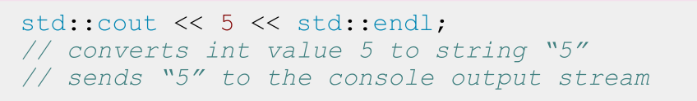
Output Streams
- Have type std::ostream
- Can only send data to the stream
- Interact with the stream using the << operator
- Converts any type into string and sends it to the
stream
- std::cout is the output stream that goes to the console

Slide 16
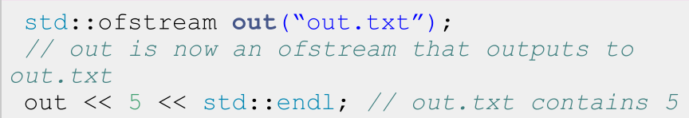
Output File Streams
- Have type std::ofstream
- Only send data using the << operator
- Converts data of any type into a string and sends it
to the file stream
- Must initialize your own ofstream object linked to yourfile

Slide 17
std::cout is a global constant object that you get from
#include <iostream>
To use any other output stream,
you must first initialize it!

Slide 18
Today
- What are streams?
- Output streams
- Input streams
- String streams!

Slide 19
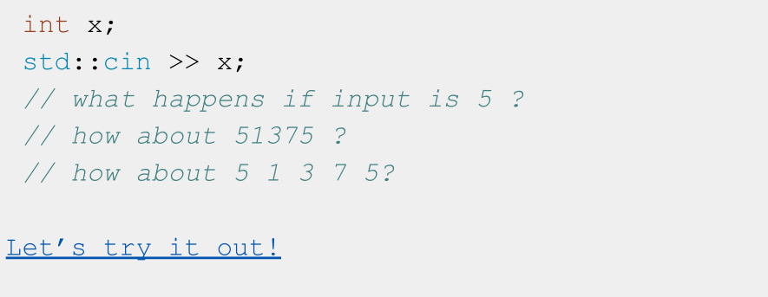
What does this code do?

Slide 20
A note about nomenclature
● “>>” is the stream extraction operator or simply extraction operator
○ Used to extract data from a stream and place it into a variable
● “<<” is the stream insertion operator or insertion operator
○ Used to insert data into a stream usually to output the data to a file, console, or string

Slide 21
std::cin is an input
stream. It has type
std::istream

Slide 22
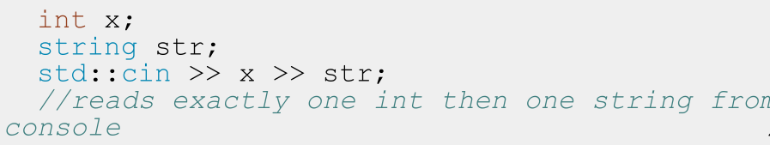
Input Streams
- Have type std::istream
- Can only receive strings using the >> operator
- Receives a string from the stream and converts it to data
- std::cin is the input stream that gets input from the console

Slide 23
Nitty Gritty Details: std::cin
- First call to std::cin >> creates a command line prompt that allows the user to type until they hit enter
- Each >> ONLY reads until the next whitespace
- Whitespace = tab, space, newline
- Everything after the first whitespace gets saved and used the next time std::cin >> is called
- The place its saved is called a buffer!
- If there is nothing waiting in the buffer, std::cin >> creates a new command line prompt
- Whitespace is eaten; it won’t show up in output

Slide 24
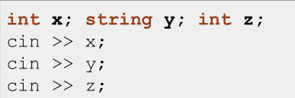
Think of a std::istream as a sequence of characters
4 | 2 |  | a | b |  | 4 | \n
position

Slide 25
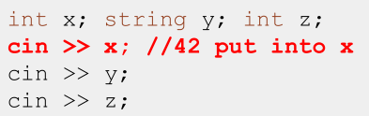
Think of a std::istream as a sequence of characters
4 | 2 |  | a | b |  | 4 | \n
position

Slide 26
Think of a std::istream as a sequence of characters
4 | 2 |  | a | b |  | 4 | \n
position

Slide 27
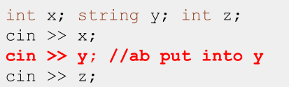
Think of a std::istream as a sequence of characters
4 | 2 |  | a | b |  | 4 | \n
position

Slide 28
Think of a std::istream as a sequence of characters
4 | 2 |  | a | b |  | 4 | \n
position

Slide 29
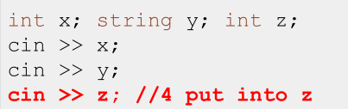
Think of a std::istream as a sequence of characters
4 | 2 |  | a | b |  | 4 | \n
position

Slide 30
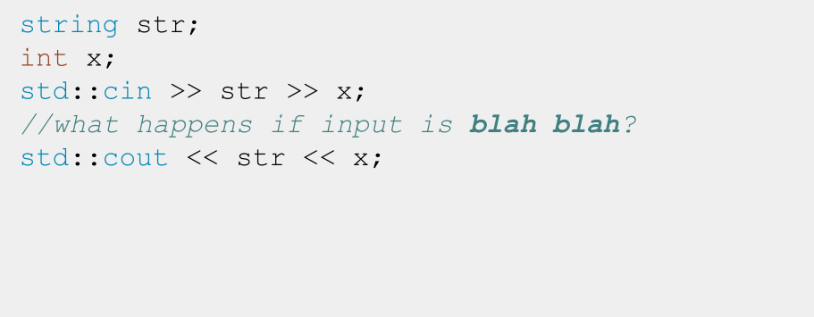
Input Streams: When things go wrong

Slide 31
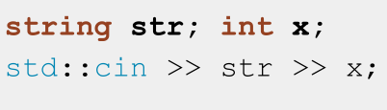
Think of a std::istream as a sequence of characters
b | l | a | h |  | b | l | a | h | \n
position

Slide 32
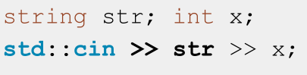
Think of a std::istream as a sequence of characters
b | l | a | h |  | b | l | a | h | \n
position

Slide 33
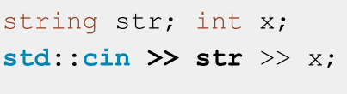
Think of a std::istream as a sequence of characters
b | l | a | h |  | b | l | a | h | \n
position

Slide 34
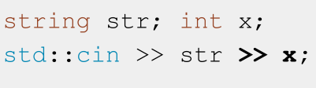
Think of a std::istream as a sequence of characters
b | l | a | h |  | b | l | a | h | \n
position

Slide 35

Think of a std::istream as a sequence of characters
FAIL
b | l | a | h |  | b | l | a | h | \n
position

Slide 36
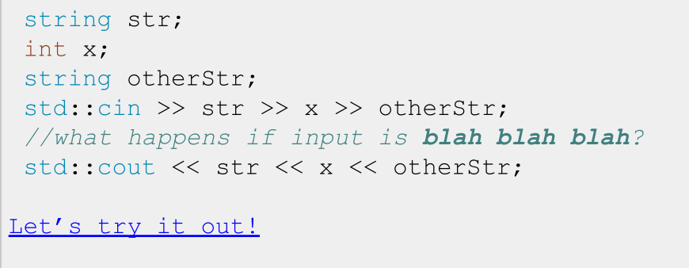
Input Streams: When things go wrong

Slide 37
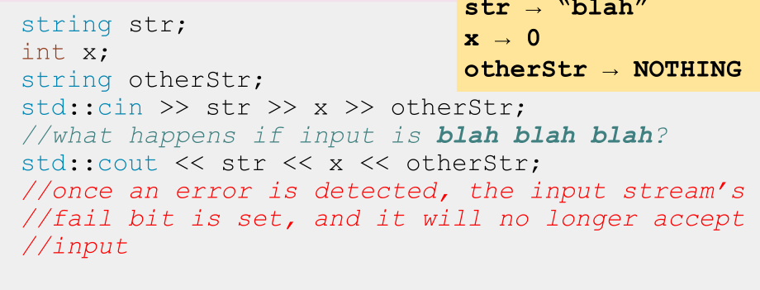
Input Streams: When things go wrong

Slide 38
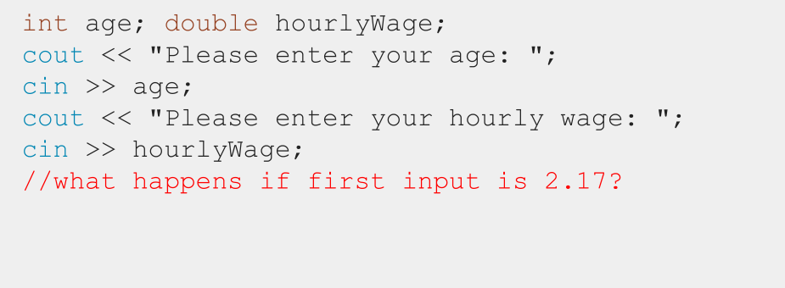
Input Streams: When things go wrong

Slide 39
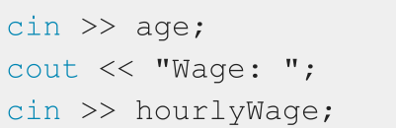
Think of a std::istream as a sequence of characters
2 | . | 1 | 7 | \n
position

Slide 40
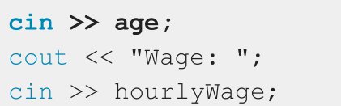
Think of a std::istream as a sequence of characters
2 | . | 1 | 7 | \n
position

Slide 41
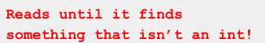
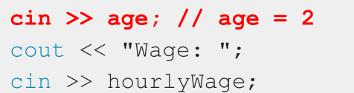
Think of a std::istream as a sequence of characters
2 | . | 1 | 7 | \n
position

Slide 42
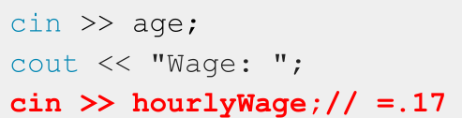
Think of a std::istream as a sequence of characters
2 | . | 1 | 7 | \n
position

Slide 43
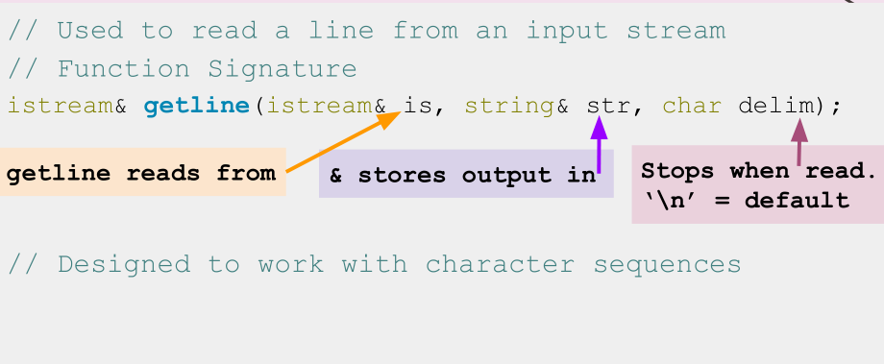
std::getline()

Slide 44
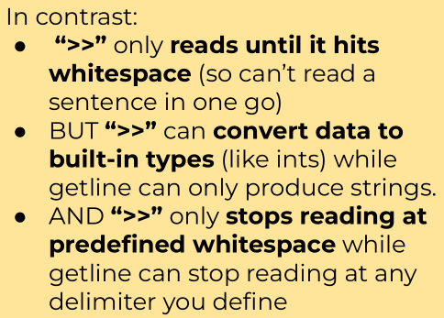
std::getline(istream& is, string& str, char delim)
- How it works:
- Clears contents in str
- Extracts chars from is and stores them in str until:
- End of file reached, sets EOF bit (checked using is.eof())
- Next char in is is delim, extracts but does not store delim
- str out of space, sets FAIL bit (checked using is.fail())
- If no chars extracted for any reason, FAIL bit set

Slide 45
Reading using >> extracts a single “word” or
built-in type
including for strings
To read a whole line, use
std::getline(istream& stream, string& line);

Slide 46
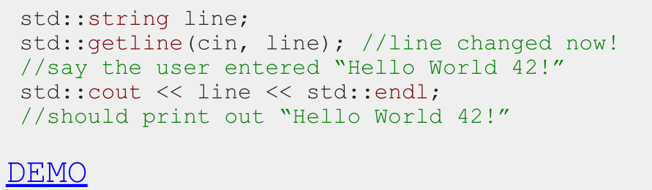
How to use getline
- Notice getline(istream& stream, string&line)takes in both parameters by reference!

Slide 47
IMPORTANT: Don’t mix >> with getline!
- >> reads up to the next whitespace character and does not go past that whitespace character.
- getline reads up to the next delimiter (by default, ‘\n’), and does go past that delimiter.
- TL;DR they don’t play nicely

Slide 48
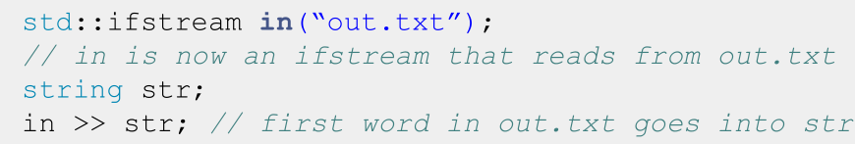
Input File Streams
- Have type std::ifstream
- Only receives strings using the >> operator
- Receives strings from a file and converts it to data of any type
- Must initialize your own ifstream object linked to your file

Slide 49
std::cin is a global constant
object that you get from
#include <iostream>
To use any other input stream, you
must first initialize it!

Slide 50
Today
- What are streams?
- Output streams
- Input streams
- String streams!

Slide 51
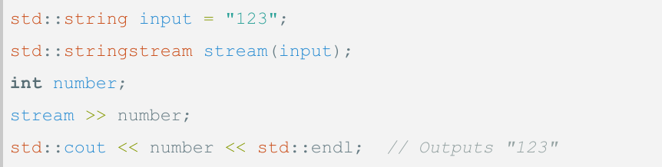
Stringstreams
- What: A stream that can read from or write to
a string object
- Purpose: Allows you to perform input/output
operations on a string as if it were a stream

Slide 52
If you only want to read OR write data:
- Read only: std::istringstream
- Give any data type to the istringstream, it’ll store it as
a string!
- Write only: std::ostringstream
- Make an ostringstream out of a string, read from it
word/type by word/type!
- Follows same patterns as the other i/ostreams!

Slide 53
Recap
- Streams convert between data of any type and the string representation of that data
- Streams have an endpoint: console for cin/cout, files for i/o fstreams, string variables for i/o stringstreams where they read in a string from or output a string to.
- To send data (in string form) to a stream, use stream_name << data
- To extract data from a stream, use stream_name >> data, and the stream will try to convert a string to whatever type data is

Slide 54
Coding for love, Coding for the world
Qijun Zhao
qjzhao@scu.edu.cn

